Slide 1
K8C
Daniel Tsurkan
Gadji Dandamaev
Tsaturyan Konstantin
Smolkin Mikhail

Slide 2
Project statement
Product provides extension of the existing ingress implementation in Kubernetes using Custom Resource Definitions (CRDs) and automatic generation of the OpenAPI scheme from source code.
The main features are:
Single Sign-On
Automatic OpenAPI scheme generation
Request validation
Response caching
Team: Daniel Tsurkan; Gadji Dandamaev; Tsaturyan Konstantin; Smolkin Mikhail
Project repo: https://github.com/fanglores/Advanced-Software-Design
This report: here

Slide 3


Roles
DevOps
Described products will benefit mostly for DevOps role. That role assume handling and managing Kubernetes cluster. They will have to configure particular .
Developer
Developer will access API Gateway and OpenAPI scheme to develop and integrate new features into existing.

Slide 4
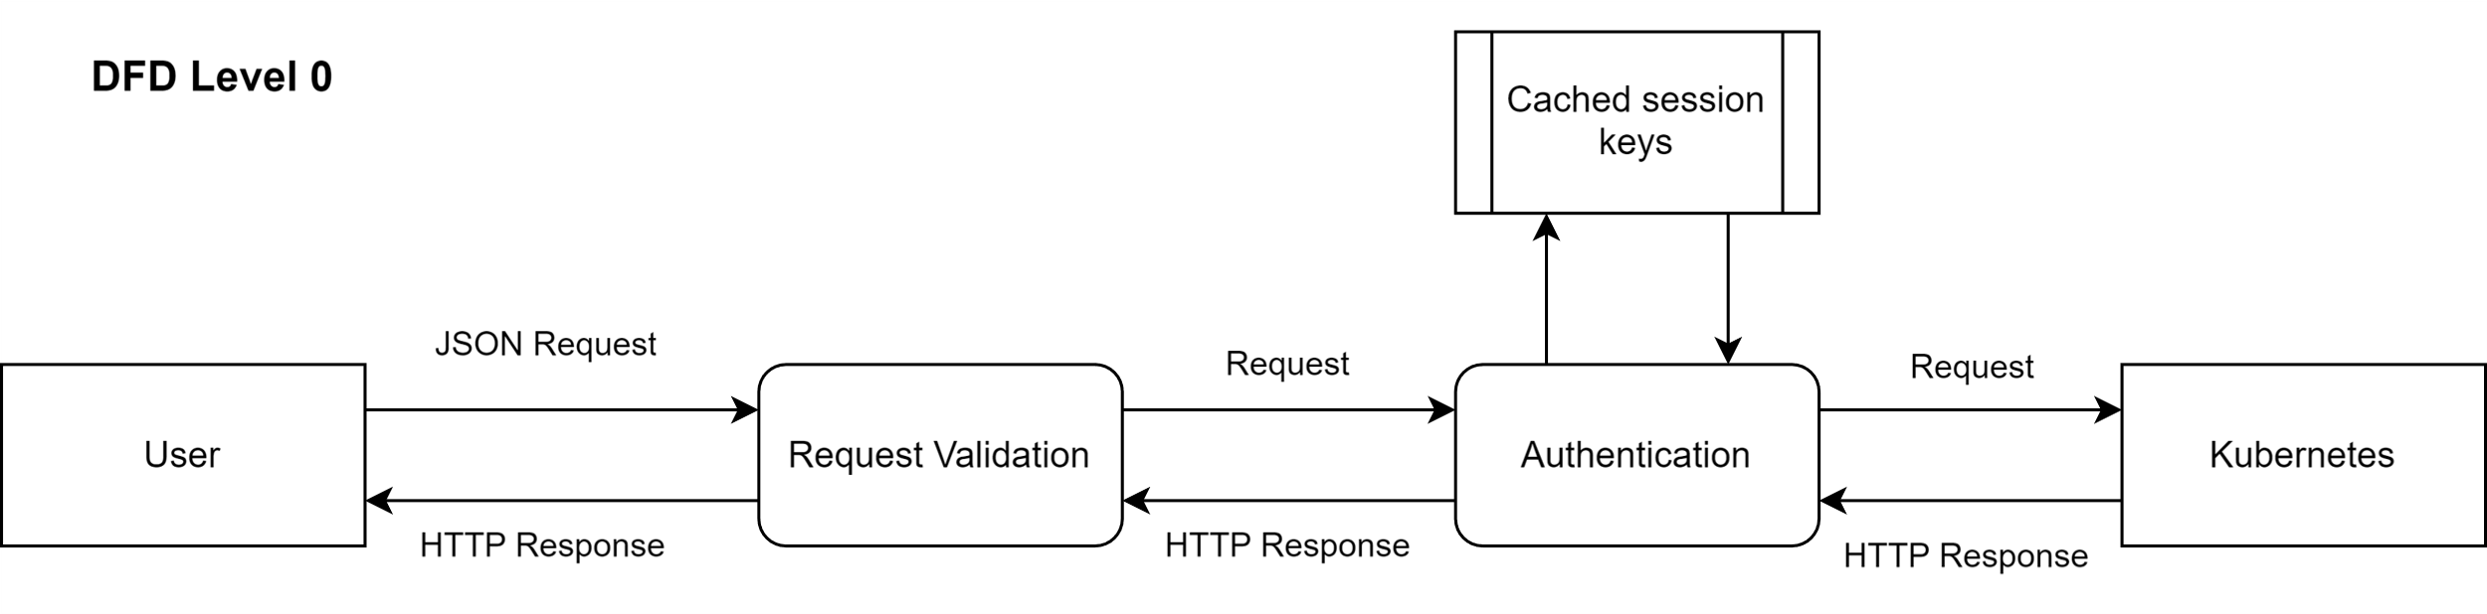
DFD (Level 0)

Slide 5
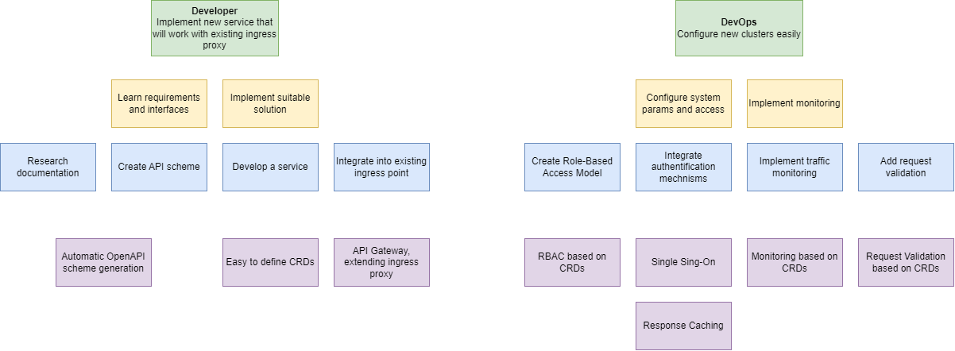
Story map

